Slide 1
Screening For Disease - When Not to Do It
Medical Grand Rounds Nov 3, 2011
Neil A Kurtzman, MD

Slide 2
Definition
The presumptive identification of unrecognized disease or defect by the application of tests, examinations, or other procedures which can be applied rapidly. Screening tests sort out apparently well persons who probably have a disease from those who probably do not. A screening test is not intended to be diagnostic.
WHO 1968

Slide 3
The Purpose of Medicine
To prevent premature death
To relieve pain and suffering

Slide 4
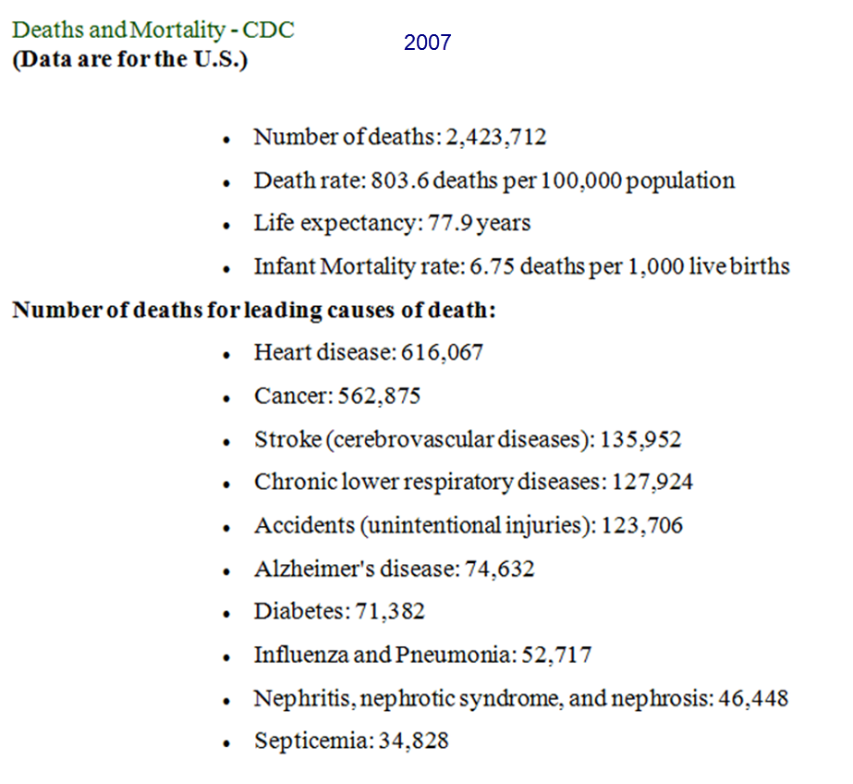

Slide 5
General Principles of Screening
The disease must be an important health problem
The natural history of the disease must be known
It must be detectable at an early (preclinical) stage
There must be reliable and "simple" tests which can detect the disease
There must be effective treatment which yields better results when applied early rather than later
Screening and subsequent treatment must be cost effective
Screening must be systematically and uniformly applied
The benefit of screening must clearly outweigh any harm caused by it

Slide 6
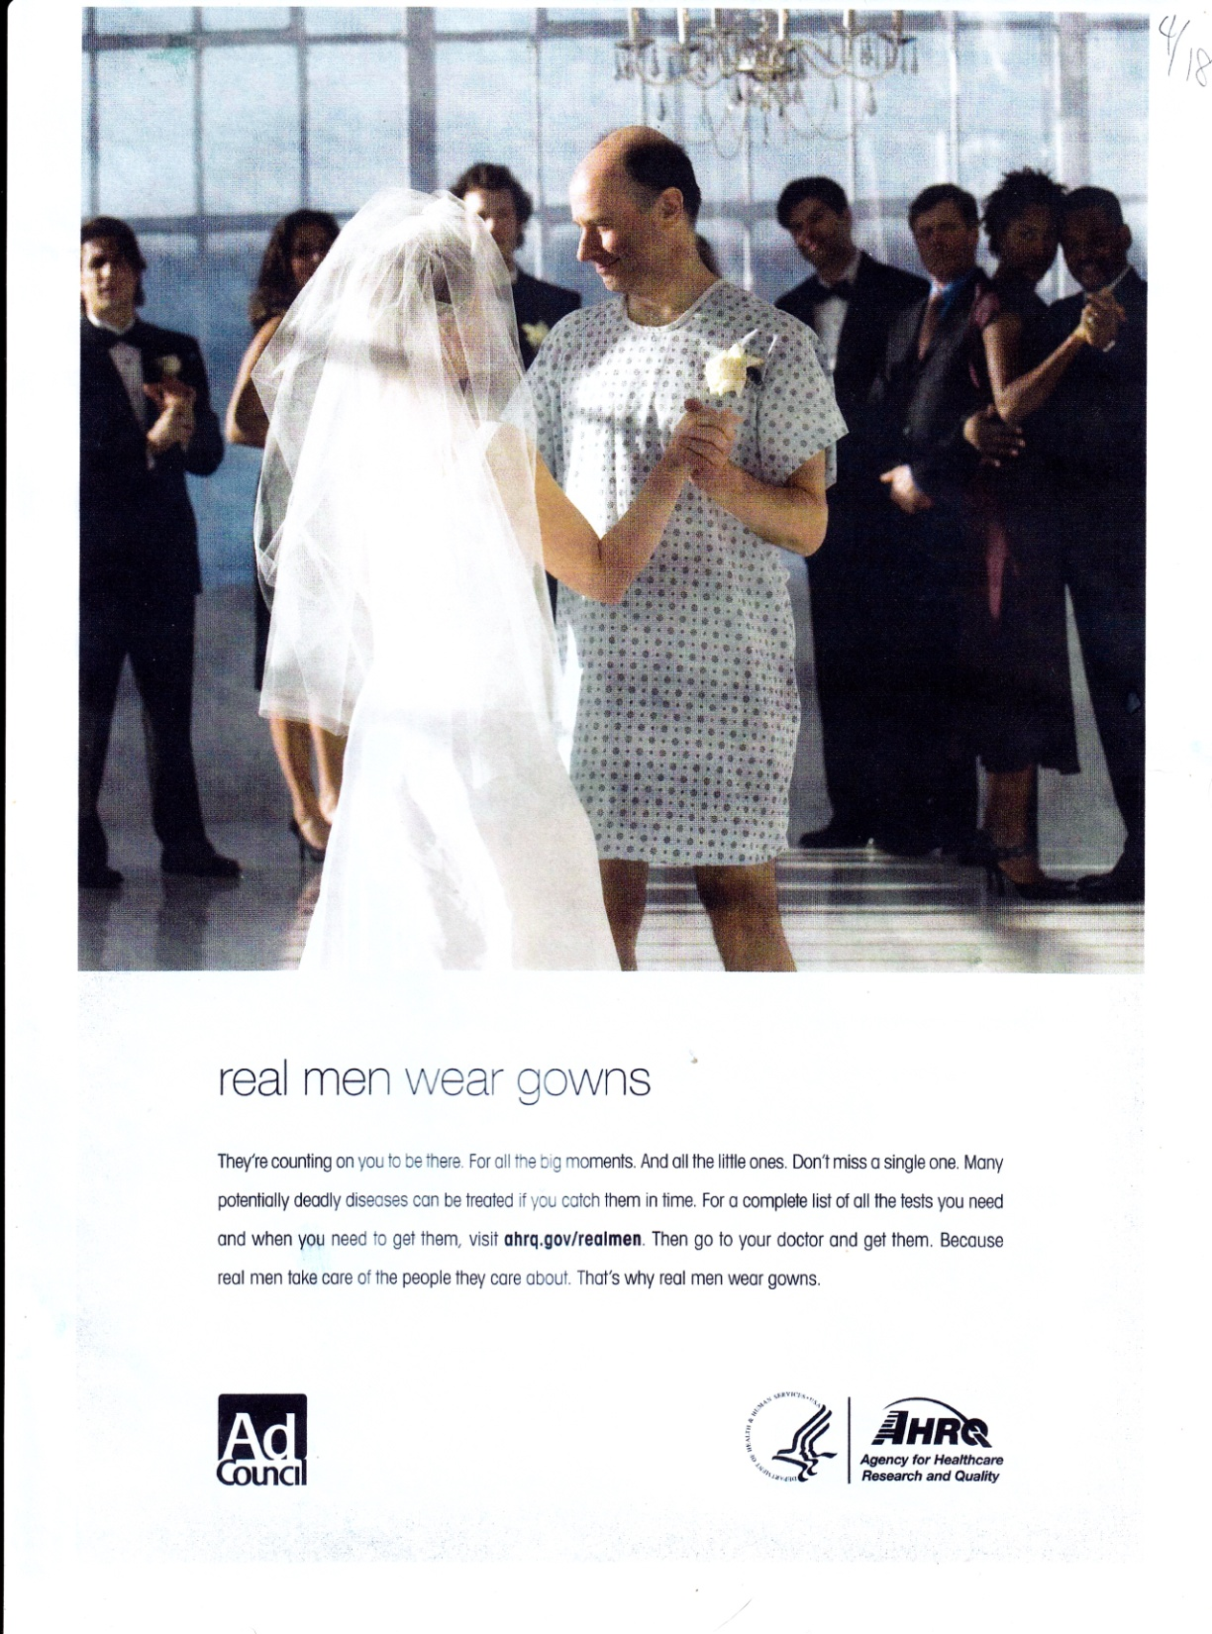

Slide 7
Wall Street Journal

Slide 8
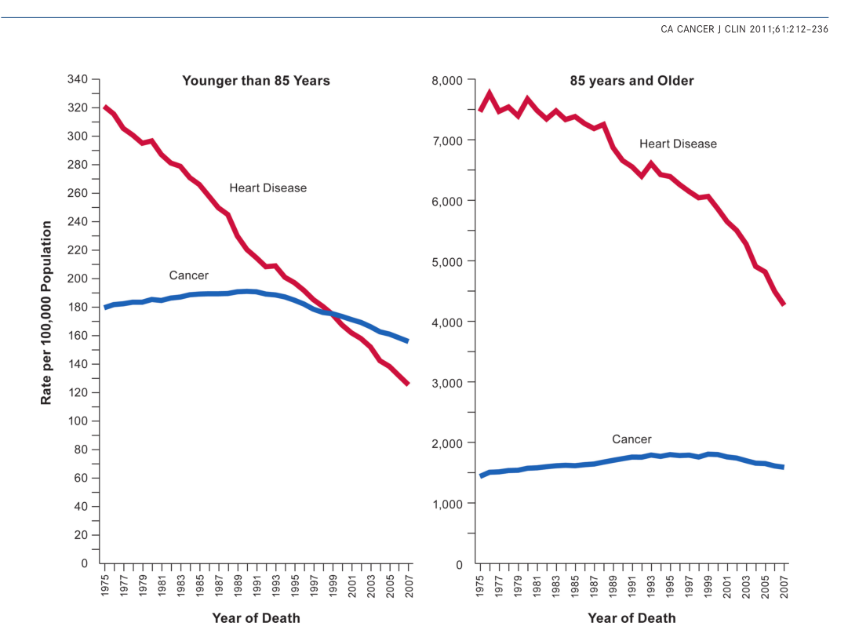
Aggressive application of nationally recommended prevention activities could prevent a high proportion of the CAD events and strokes that are otherwise expected to occur in adults in the United States today. However, as they are currently delivered, most of the prevention activities will substantially increase costs. If preventive strategies are to achieve their full potential, ways must be found to reduce the costs and deliver prevention activities more efficiently.
Circulation 118:578, 2008

Slide 9
U.S. Dept. of Commerce, Bureau of the Census, Historical Statistics of the United States

Slide 10
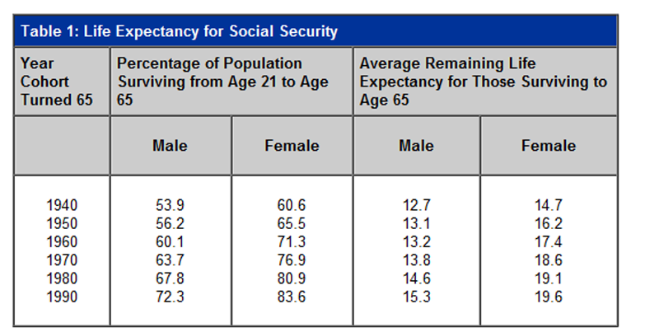

Slide 11
We have more old people
Mainly because we have more 40 year olds
Old people don’t live that much longer than they did 160 years ago

Slide 12
Intrinsic Limitations of Screening
1. Sensitivity
2. Specificity
3. Positive Predicative Value

Slide 13
Sensitivity
The % who have the disease and test positive

Slide 14
Specificity
The % that don’t have the disease and test negative

Slide 15
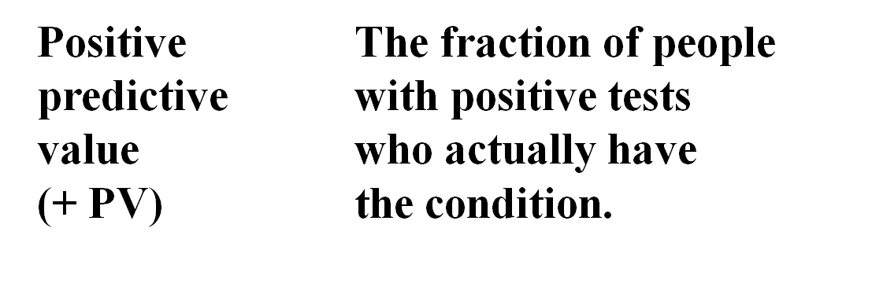

Slide 17
You must know the prevalence of a disease to calculate the PPV of a positive screening test
Disease X has a prevalence of 1%
The screening test is 95% sensitive
1 million people are screened

Slide 18
10,000 people have the disease
9,500 with the disease test positive
50,000 give false positive results
PPV = 16%
9,500/(9,500 + 50,000)

Slide 19
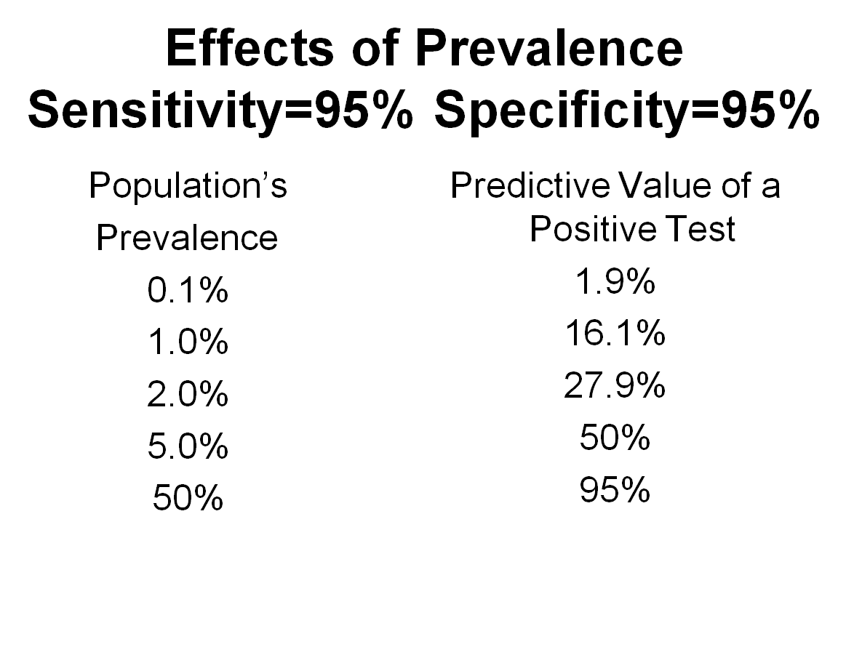

Slide 20
The lower the prevalence the lower the PPV
The lower the sensitivity the lower the PPV
False positives are the bane of screening

Slide 21
The Screening Paradox
Those in whom the most will be found will reap the smallest benefit – ie, the elderly
PPV increases with prevalence

Slide 22
We have just about reached the fate of Tithonus
“[B]ut when loathsome old age pressed full upon him, and he could not move nor lift his limbs, this seemed to her (Eos) in her heart the best counsel: she laid him in a room and put to the shining doors. There he babbles endlessly, and no more has strength at all, such as once he had in his supple limbs." (Homeric Hymn to Aphrodite)

Slide 23
Examples of Screening
Cancer
Diabetes Mellitus
Cholesterol
AAA

Slide 24
Lead Time Bias

Slide 25
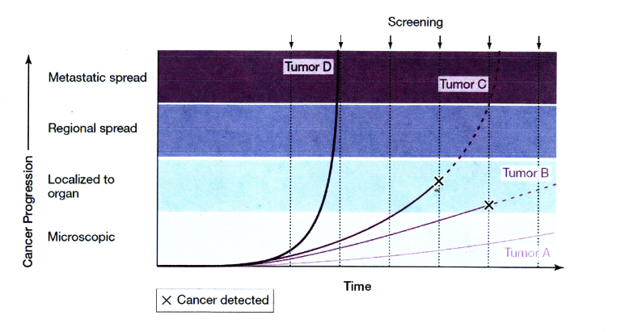

Slide 26
Cancer Statistics, 2011
CA Cancer J Clin 2011;61:212-236

Slide 27
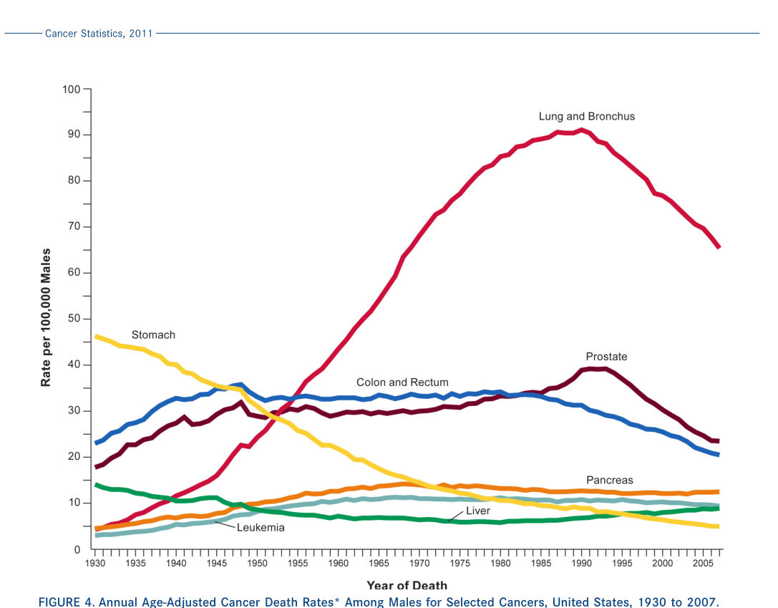

Slide 28
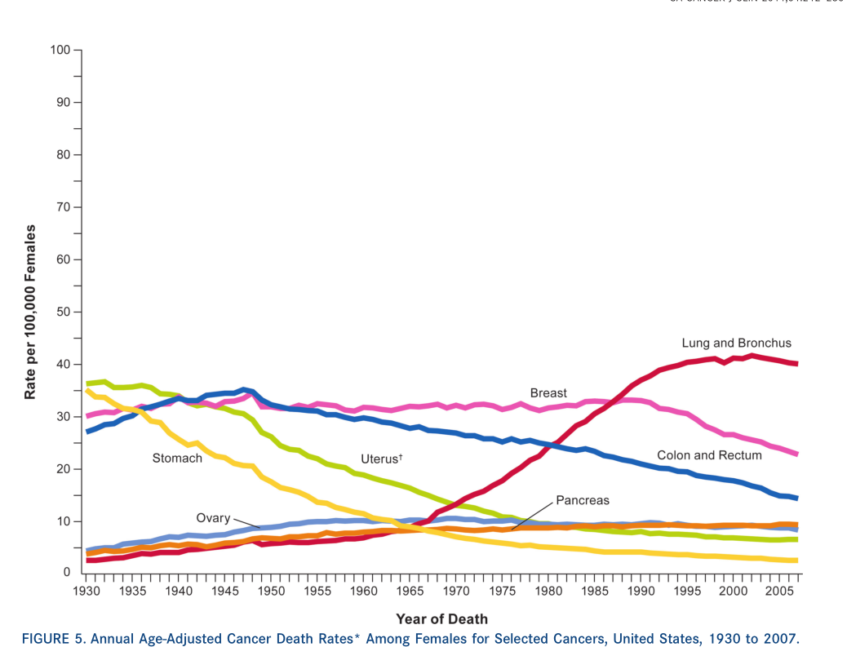

Slide 29
Aggressive application of nationally recommended prevention activities could prevent a high proportion of the CAD events and strokes that are otherwise expected to occur in adults in the United States today. However, as they are currently delivered, most of the prevention activities will substantially increase costs. If preventive strategies are to achieve their full potential, ways must be found to reduce the costs and deliver prevention activities more efficiently.
Circulation 118:578, 2008

Slide 30
Now expert groups are proposing less screening for prostate, breast and cervical cancer and have emphasized that screening comes with harms as well as benefits.
http://www.nytimes.com/2011/10/30/health/cancer-screening-may-be-more-popular-than-useful.html?_r=1&emc=eta1

Slide 31
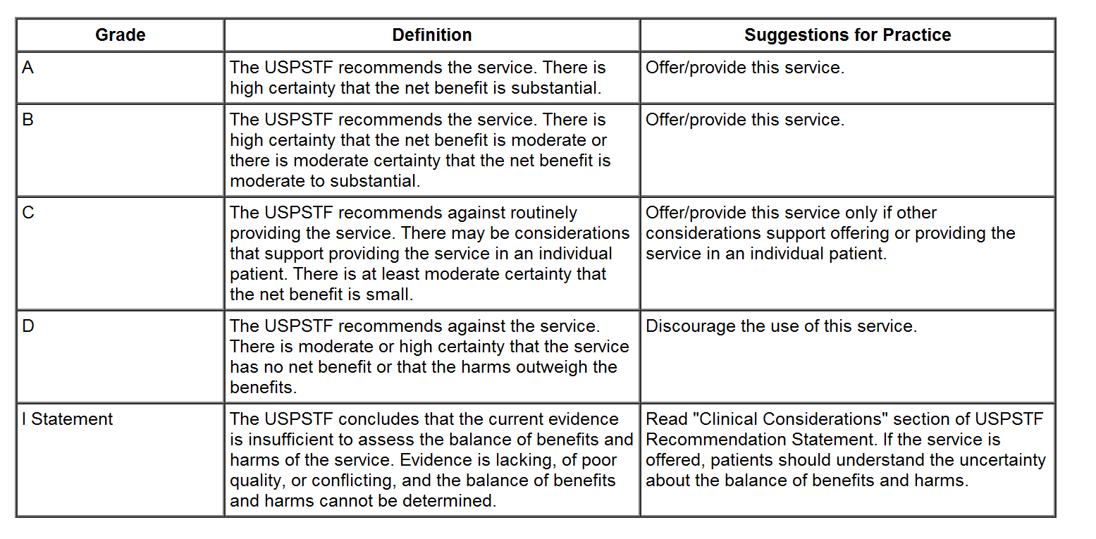

Slide 32
The U.S. Preventive Services Task Force recommends screening mammography, with or without clinical breast examination, every 1-2 years for women aged 40 and older.
Grade:B recommendation.
2002

Slide 33
The USPSTF recommends biennial screening mammography for women aged 50 to 74 years.
Grade: B recommendation.
2009

Slide 34
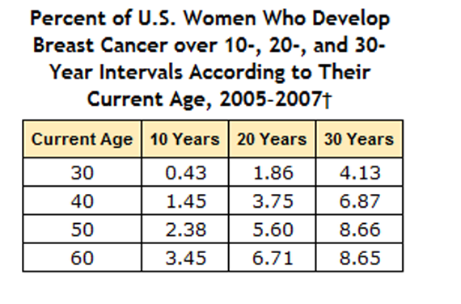
http://www.cdc.gov/cancer/breast/statistics/age.htm

Slide 35
This suggests a PPV of around 1% or less for screening mammography in women less than 50

Slide 36
Ann Intern Med. 2002;137:305-312

Slide 37
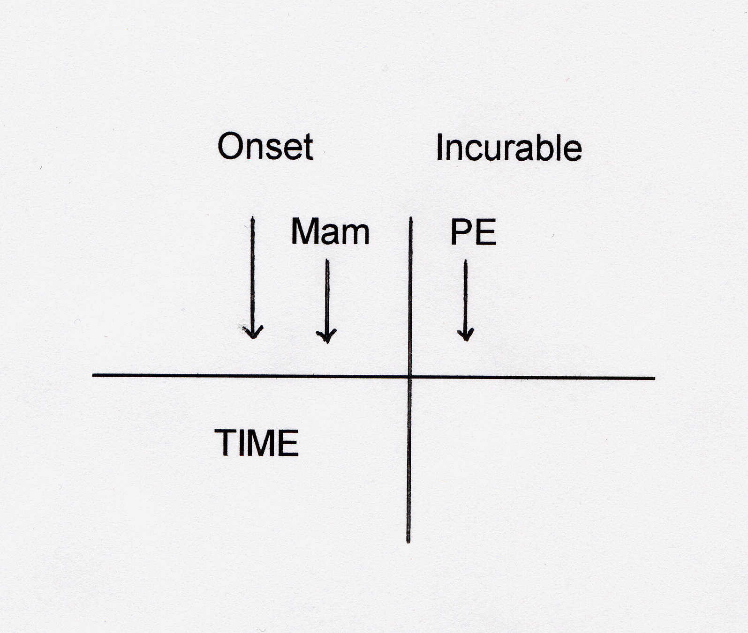

Slide 39
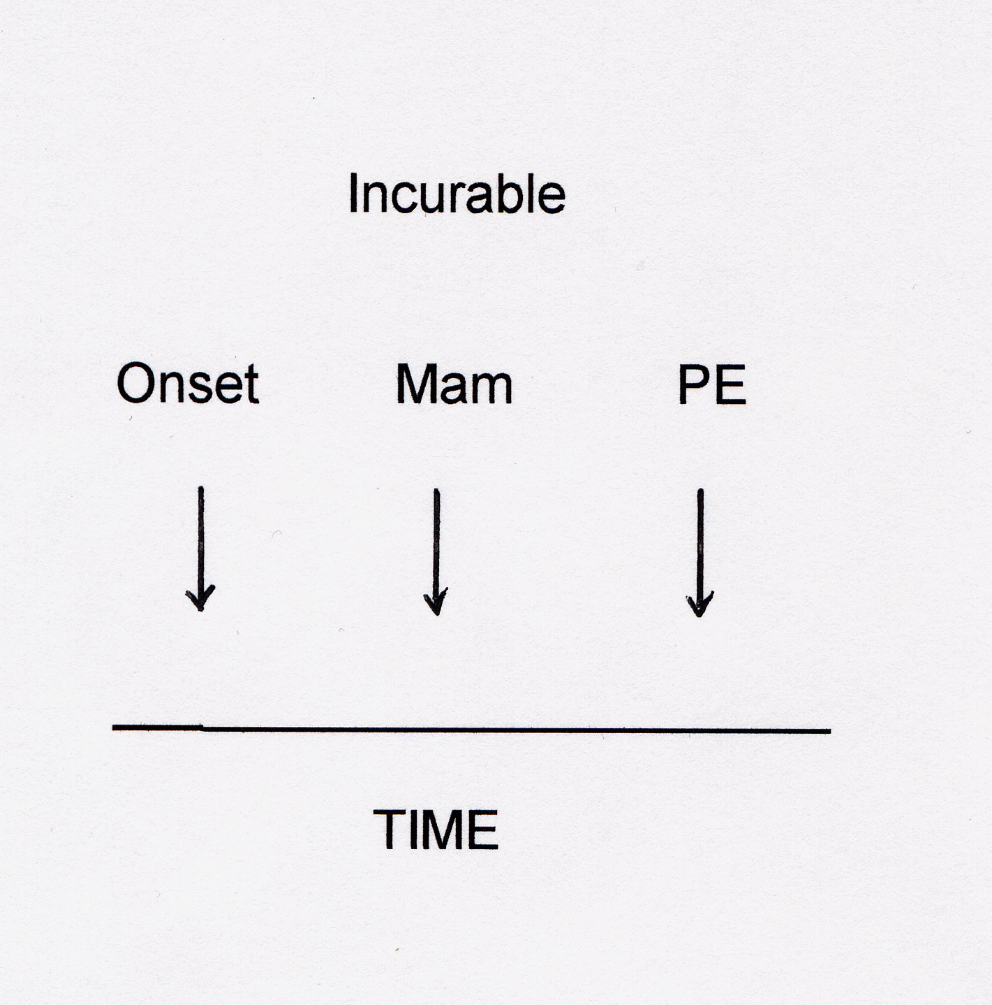

Slide 40
The sensitivity of mammography is about 75%
True for all ages
Sydney Breast Imaging Accuracy Study
http://www.amberheart.net/youngwomen3.pdf

Slide 41
PPV is about 5 – 7%

Slide 42
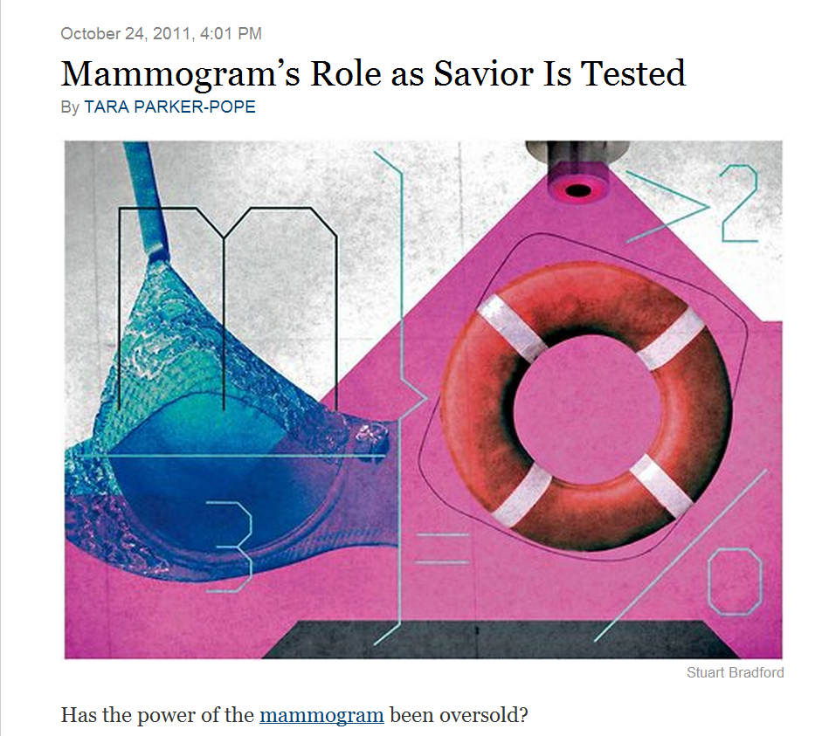
New York Times

Slide 43
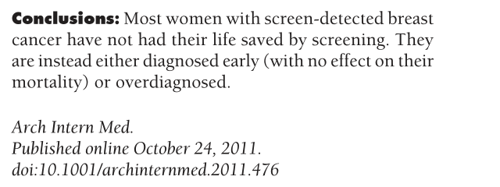

Slide 44
Cervical Cancer
For women 30 years and older, at average risk of cancer, a screening interval of every 3 years is recommended for cytology alone

Slide 45
Estimated new cases and deaths from cervical cancer in the United States in 2011:
New cases: 12,710
Deaths: 4,290
http://www.cancer.gov/cancertopics/types/cervical

Slide 46
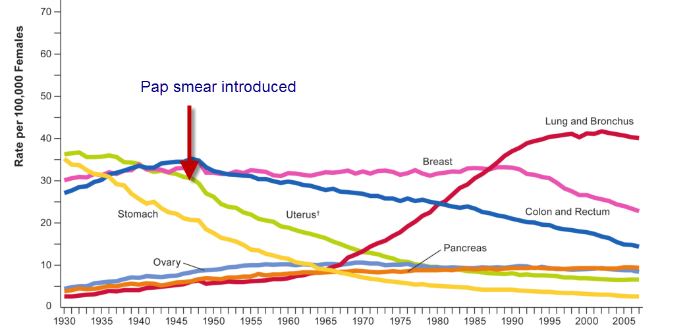

Slide 47
Must screen 3500 women to find 1 case
Sensitivity of a Pap smear is 50 – 70%
17.5 million false positives if above is true and assuming that 35 million women screened annually

Slide 48
Today the incidence of cervical cancer is less than the death rate in 1930
Screening for a disease increases its incidence
This suggests that the behavior of the disease has changed
The same pattern characterizes stomach cancer

Slide 49
About one person in 3,500 has lupus
Should we screen for lupus?
http://www.thelupussite.com/fact1.html

Slide 50
Prostate Cancer
Incidence: 170 per 100,000
Deaths: 25 per 100,000
Mortality relatively unchanged
Incidence about doubled

Slide 52
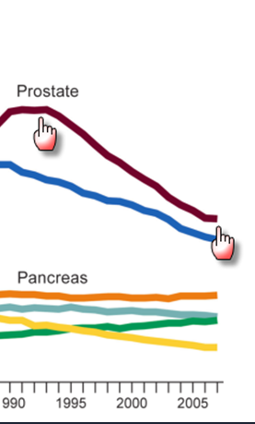
Prostate Cancer

Slide 53
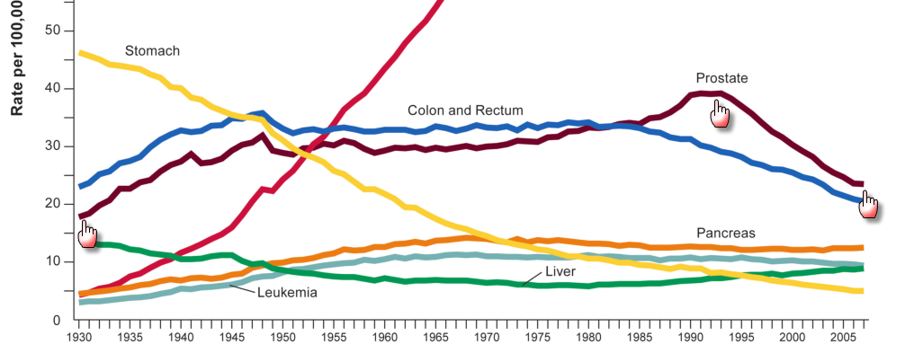

Slide 54
http://www.uspreventiveservicestaskforce.org/draftrec3.htm
Oct 7, 2011

Slide 56
The ACP and AAFP do not recommend PSA screening
The ACS no longer does
Only the AUA still recommends it

Slide 57
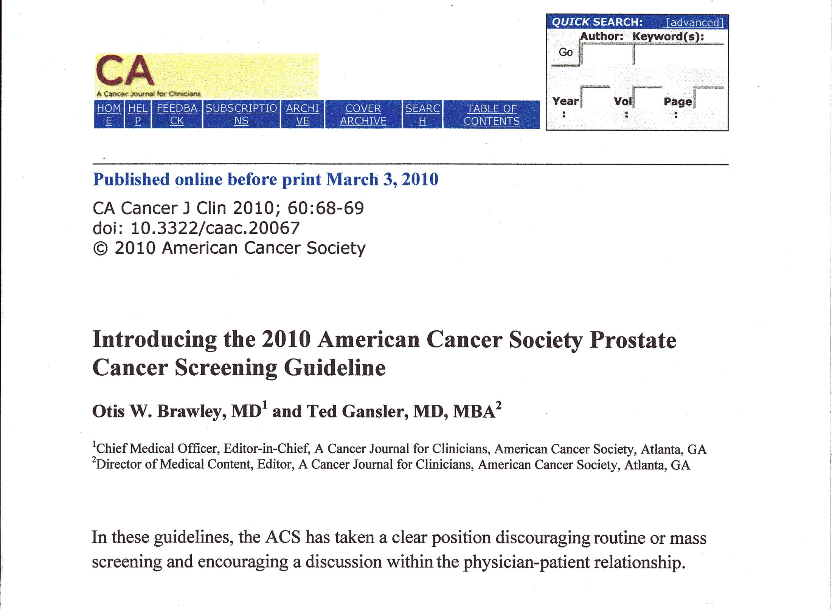

Slide 58
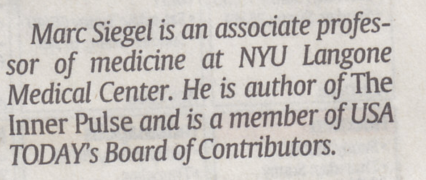

Slide 59
http://www.nejm.org/doi/pdf/10.1056/NEJMcp1103642

Slide 60
[W]e primary care clinicians must ensure there is no more routine, indiscriminate PSA screening — and no washing our hands of responsibility once the patient is referred to a specialist for prostate-cancer treatment. We owe it to our patients to provide them with the kind of guidance about this screening test that they need and deserve. That's the way to help put the controversy to rest . . . one man at a time.
http://www.nejm.org/doi/full/10.1056/NEJMp1111894

Slide 61
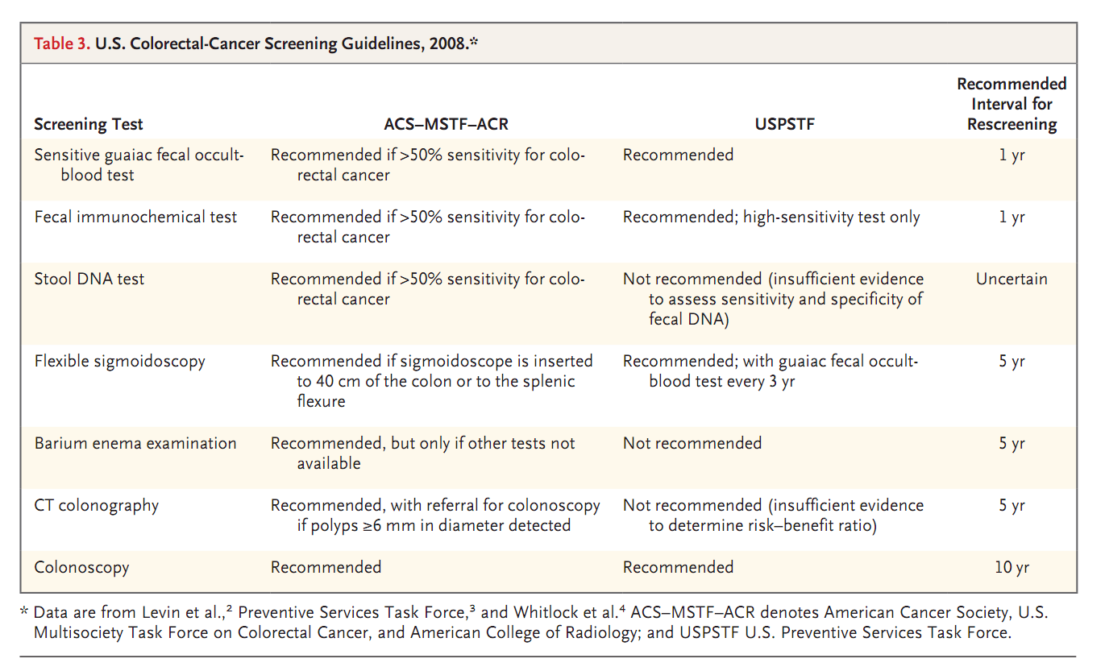

Slide 62
Definition
The presumptive identification of unrecognized disease or defect by the application of tests, examinations, or other procedures which can be applied rapidly. Screening tests sort out apparently well persons who probably have a disease from those who probably do not. A screening test is not intended to be diagnostic.
WHO 1968

Slide 64
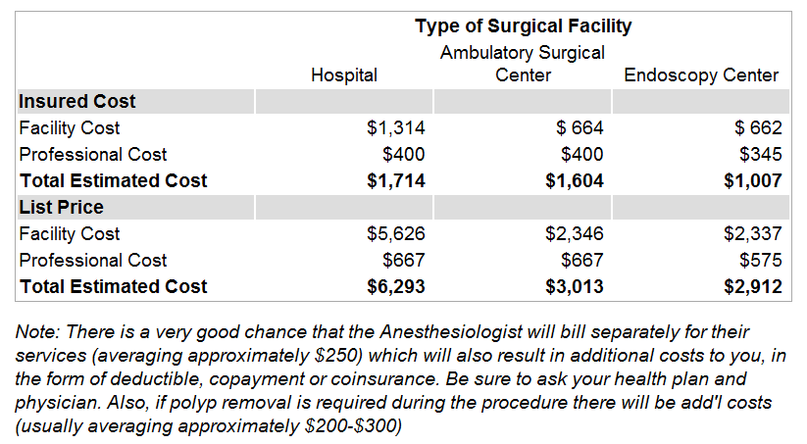
Cost of a colonoscopy
http://colonoscopycosts.com/

Slide 65
Summary of Recommendations
The USPSTF recommends screening for colorectal cancer (CRC) using fecal occult blood testing, sigmoidoscopy, or colonoscopy, in adults, beginning at age 50 years and continuing until age 75 years. The risks and benefits of these screening methods vary. Grade: A Recommendation.

Slide 66
The USPSTF recommends against routine screening for colorectal cancer in adults age 76 to 85 years. There may be considerations that support colorectal cancer screening in an individual patient. Grade: C Recommendation.

Slide 67
The USPSTF recommends against screening for colorectal cancer in adults older than age 85 years. Grade: D Recommendation.
http://www.uspreventiveservicestaskforce.org/uspstf/uspscolo.htm

Slide 68
The USPSTF concludes that the evidence is insufficient to assess the benefits and harms of computed tomographic colonography and fecal DNA testing as screening modalities for colorectal cancer. Grade: I Statement.

Slide 69
CDC 2011
Criteria supporting screening for diabetes include:
a large and growing disease burden
a well understood natural history
a recognizable preclinical stage when diabetes can be diagnosed, but the person has no symptoms
tests that are available that can detect undiagnosed diabetes in the preclinical stage.

Slide 70
Criteria not supporting screening include:
no definitive studies have shown that early detection and treatment reduce long-term complications.
whether the cost of case finding and treatment are balanced in relationship to health expenditures as a whole.
no uniform screening process has been adopted so that screening is ongoing and systematic.

Slide 71
[T]here are no randomized trials demonstrating the benefits of early diagnosis through screening (for Type 2 DM) of asymptomatic individuals. Nevertheless, there is sufficient indirect evidence to justify opportunistic screening in a clinical setting of individuals at high risk.
ADA 2007

Slide 72
The U.S. Preventive Services Task Force (USPSTF) strongly recommends screening men aged 35 and older for lipid disorders. Grade: A Recommendation.
The USPSTF recommends screening men aged 20 to 35 for lipid disorders if they are at increased risk for coronary heart disease. Grade: B Recommendation.
June 2008

Slide 73
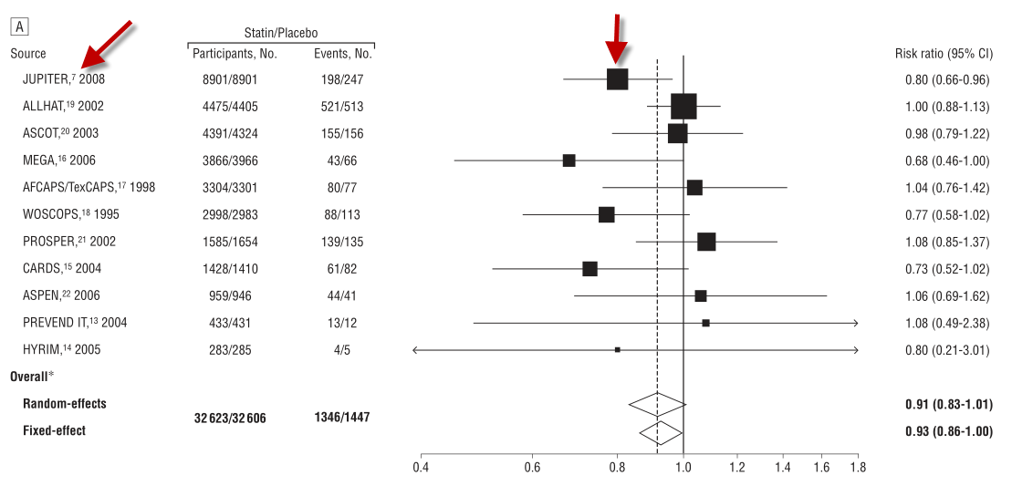
Primary Prevention

Slide 74
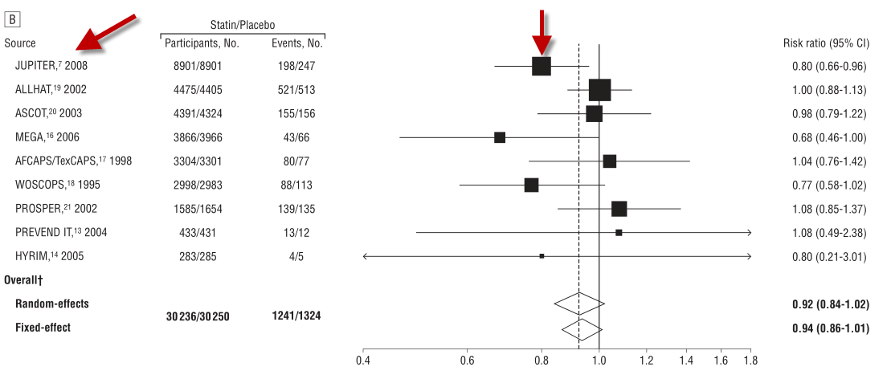
Diabetics Excluded

Slide 75
Conclusion: This literature-based meta-analysis did not
Find evidence for the benefit of statin therapy on all-cause mortality in a high-risk primary prevention set-up.
ARCH INTERN MED/VOL 170 (NO. 12), JUNE 28, 2010

Slide 76
Screening for Abdominal Aortic Aneurysm
The USPSTF recommends one-time screening for abdominal aortic aneurysm (AAA) by ultrasonography in men aged 65 to 75 who have ever smoked. Grade: B Recommendation.

Slide 77
Does ultrasound screening for abdominal aortic aneurysm improve mortality in men over 65?
PRACTICE RECOMMENDATIONS
Screening for abdominal aortic aneurysm (AAA) in men over age 65 years reduced their mortality related to AAA, but did not affect overall mortality. Therefore, population-based screening for AAA cannot be recommended.
Lancet 2002; 360:1531–1539.

Slide 78
The failure of screening is a sign of success
We have licked the main causes of premature death
People are dying from the inevitable effects of aging

Slide 79
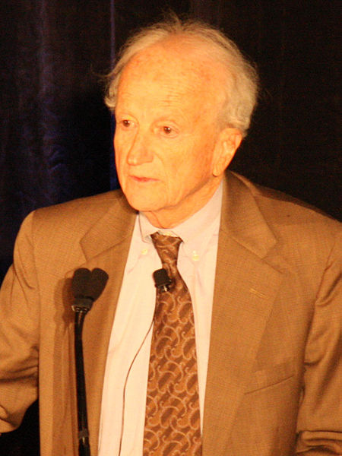
Gary Becker 1994 Nobel Laureate in Economics

Slide 80
Preventive care is often considered the gold standard of good medical practice. It is easy to get both doctors and patients to agree when either the government (i.e., taxpayers) or insurance companies (i.e., others who are insured) pay the vast majority of the costs. A rethinking of this standard is warranted, and such a rethinking would be encouraged if individuals paid a much larger fraction of their out of pocket medical expenses.
Gary Becker Nobel Prize winner in Economics
http://www.becker-posner-blog.com/2011/02/how-beneficial-is-widespread-medical-screening-becker.html

Slide 81
The Advisory Committee on Immunization Practices made the recommendation Tuesday. Oct 25, 2011
Cost more than $500 per subject
Cost to vaccinate the entire US population $150 billion

Slide 82
This vaccine is made by Merck (Gardasil) and GlaxoSmithKline (Cervarix)

Slide 83
The cost:benefit ratio of medical screening is not clear
It likely is unfavorable
It (screening) also is irresistible

Slide 84
With the possible exception of blood pressure generalized screening of an increasingly aging population has little health benefit though it carries an enormous cost

Slide 85
Most of what’s preventable is already being prevented
Immunizations
Sanitation
Prenatal care
Nutrition

Slide 86
A serious examination of risk:benefit
And cost: benefit are urgently needed
As is education of both the public and the profession

Slide 87
30

Slide 90
Screening for Osteoporosis
The U.S. Preventive Services Task Force (USPSTF) recommends that women aged 65 and older be screened routinely for osteoporosis. The USPSTF recommends that routine screening begin at age 60 for women at increased risk for osteoporotic fractures
Rating: B Recommendation.

Slide 91
Aggressive application of nationally recommended prevention activities could prevent a high proportion of the CAD events and strokes that are otherwise expected to occur in adults in the United States today. However, as they are currently delivered, most of the prevention activities will substantially increase costs. If preventive strategies are to achieve their full potential, ways must be found to reduce the costs and deliver prevention activities more efficiently.
Circulation 118:576, 2008

